Slide 1
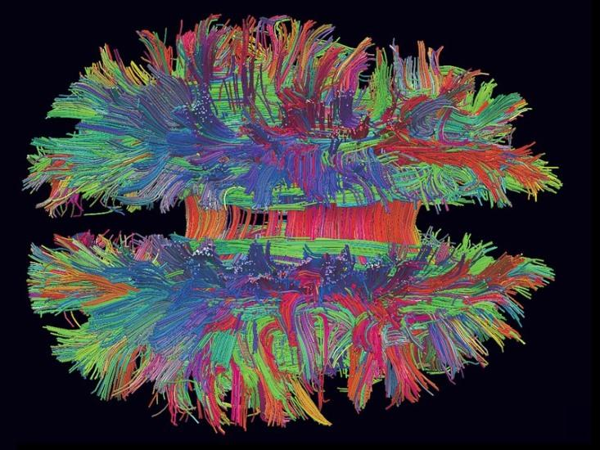
The Neuroscience of Emotions Part 3
Sangeeta Das Bhattacharya MD,MPH
School of Medical Science and Technology IIT Kharagpur

Slide 2
Neuroscience of Emotion Part 1
4 Principles
Degeneracy
Simulation
Prediction
Concepts
2 Theories
Classic Theory
Theory of Constructed Emotion
1 Large Network of Neurons
Interoceptive Network

Slide 3
Neuroscience of Emotion Part 2
1 Large Network of Neurons
Control Network
1 Theory of Brain Organization
Concept Cascade
2 Big Ideas
Social Reality
Collective Intentionality

Slide 4
Two Big Ideas
Social Reality
Creations of not individual minds but collections of human minds
Collective Intentionality
Shared knowledge

Slide 5
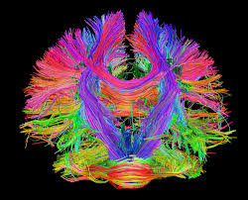
The Brain:
Billions of Prediction loops creating intrinsic brain activity

Slide 6
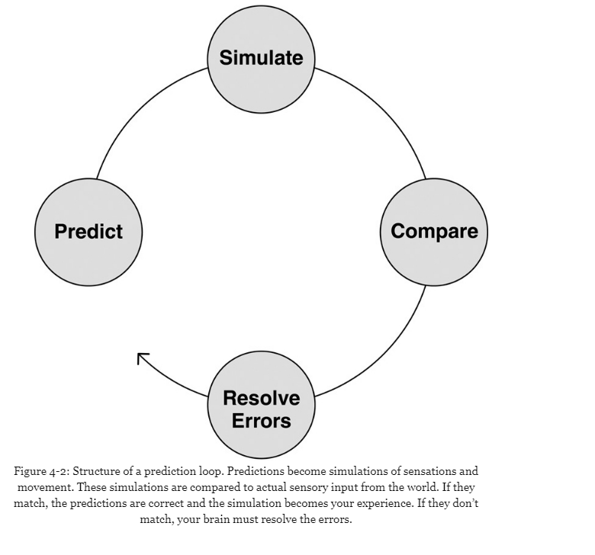

Slide 7

To See or Not to See
Patient Values
7 Case Studies
We are not given the world: we make our world through incessant experience, categorization, memory, reconnection.
Defects, disorders, diseases, in this sense can play a paradoxical role by bringing out latent powers…that might never be seen or imaginable in their absence.
-Dr. Oliver Sacks

Slide 8
Emotional Granularity
Feeling Awesome
Feeling Crappy

Slide 9


Slide 10
Re-categorization

Slide 11
Neuroscience of Emotion Part 3
1 Concept
Emotional Granularity
1 Skill
Re-categorization
4 Things we can do for emotional resilience

Slide 12

Four Things We Can Do
For Emotional Resilience
Take care of your body budget
Learn new concepts
Move your body
Cultivate awe

